Slide 1
Linear Algebra
Lecture 7

Slide 2
Systems of
Linear Equations

Slide 3
Solution Set of
Linear Systems

Slide 4
Homogenous
Linear Systems
A system of linear equations is said to be homogeneous if it can be written in the form Ax = 0, where A is an mxn matrix and 0 is the zero vector in R^{m}

Slide 5
Trivial Solution
Such a system Ax = 0 always has at least one solution, namely, x = 0
(the zero vector in R^{n}).
This zero solution is usually called the trivial solution.

Slide 6
Non Trivial Solution
The homogeneous equation Ax = 0 has a nontrivial solution if and only if the equation has at least one free variable.

Slide 7
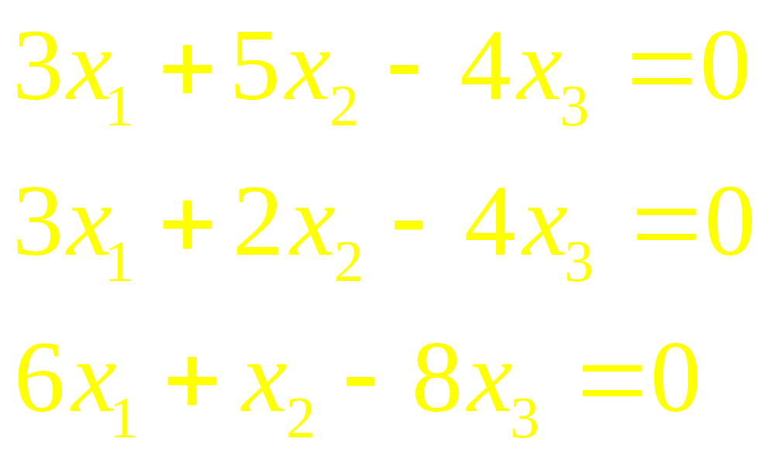
Example 1

Slide 8
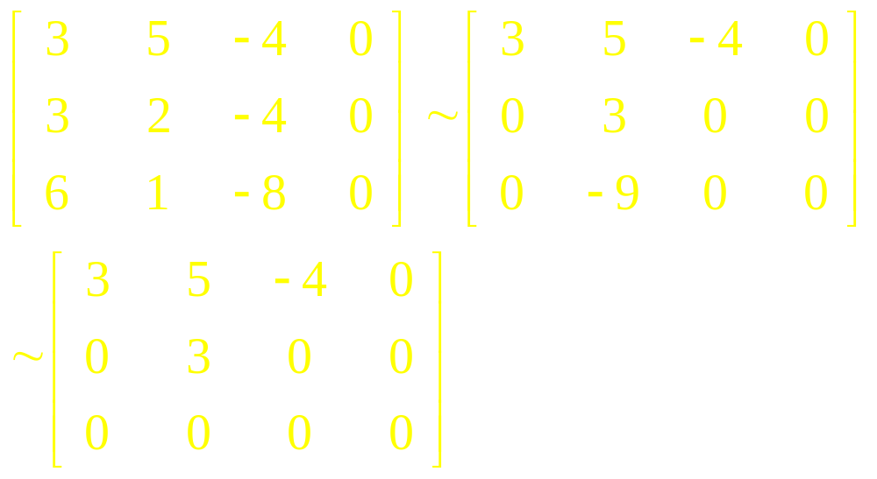
Solution

Slide 9
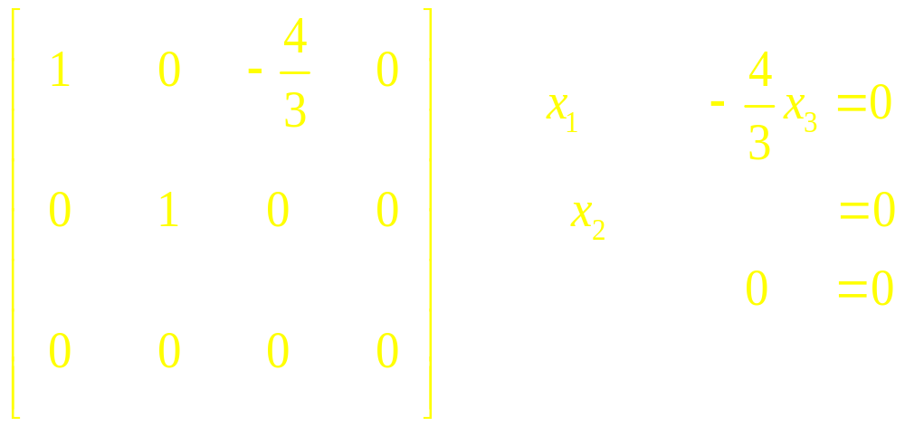
Non Trivial Solution

Slide 10
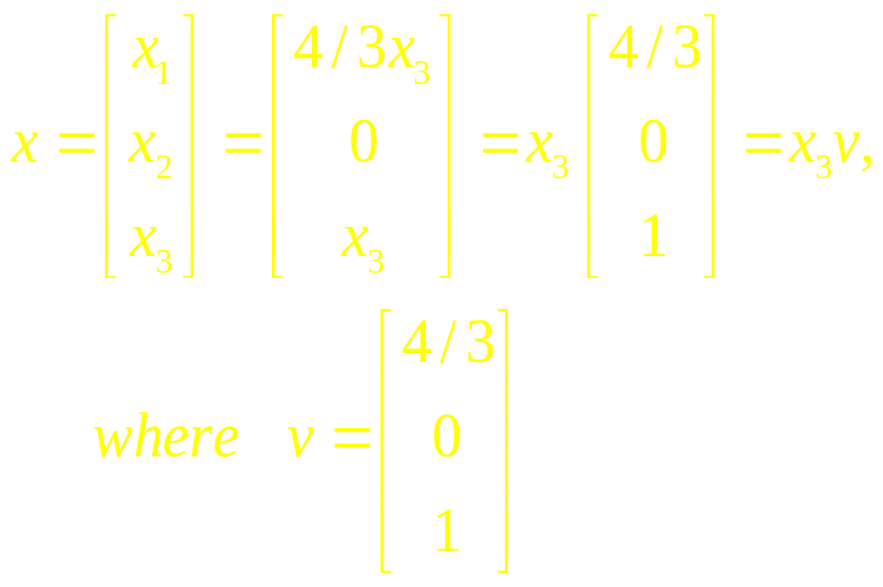
Non Trivial Solution

Slide 11
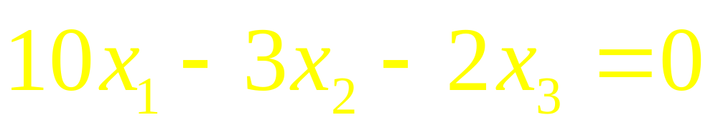
Example 2
Find all the Solutions of

Slide 12
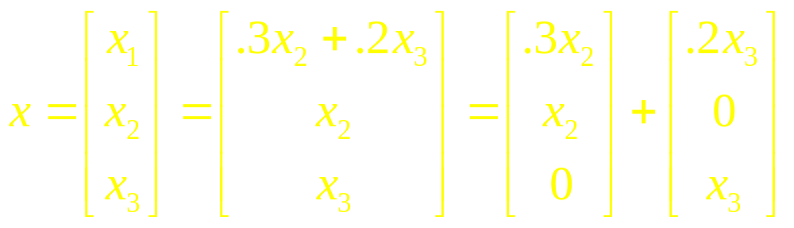
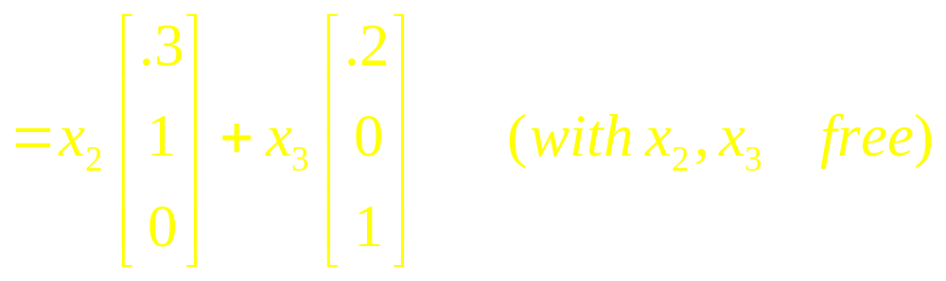
Solution

Slide 13
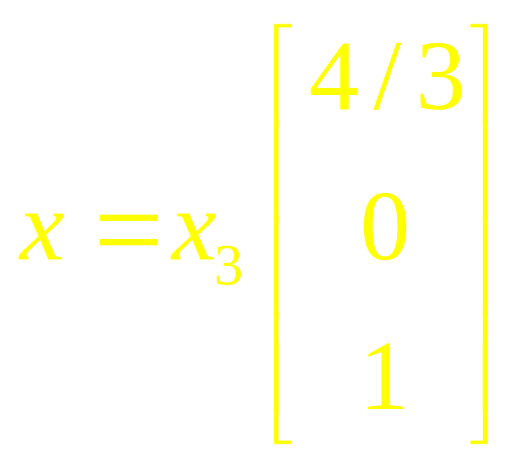
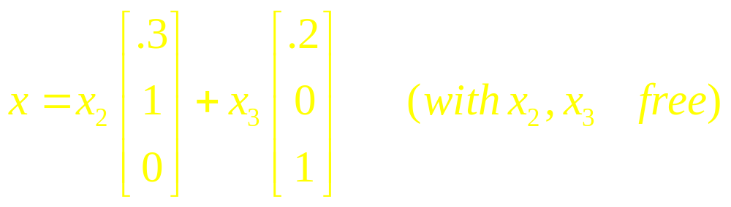
Solution
Parametric Vector Form

Slide 14
Note
Solution Set of a HE Ax=0 can be expressed explicitly as Span of suitable vectors.
If only solution is the zero vector then the solution set is Span{0}

Slide 15
Solutions of Non-homogenous Systems
When a non-homogeneous linear system has many solutions, the general solution can be written in parametric vector form as one vector plus an arbitrary linear combination of vectors that satisfy the corresponding homogeneous system.

Slide 16
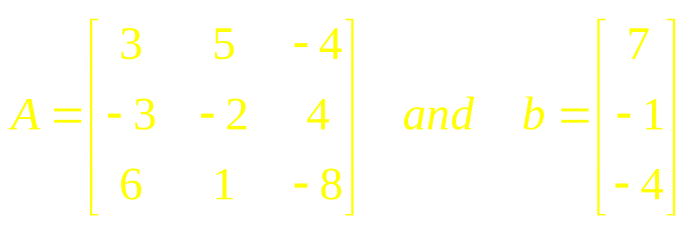
Example 2
Find all Solutions of Ax=b, where

Slide 17
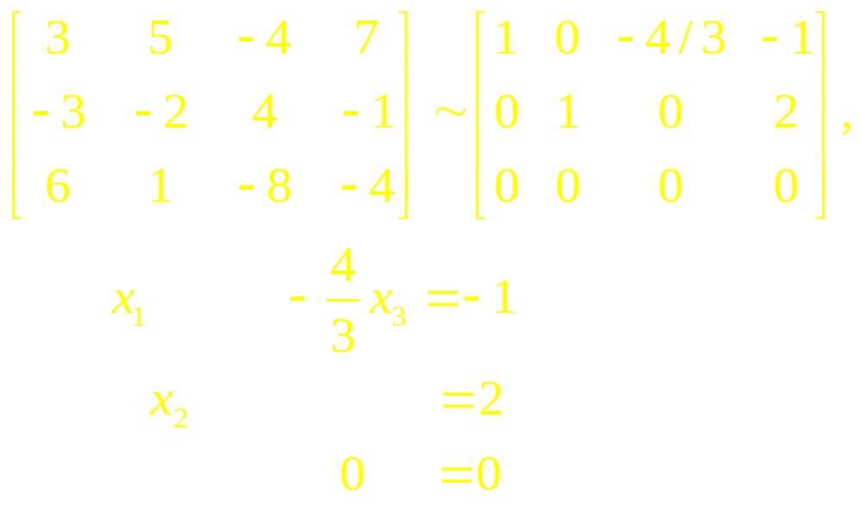
Solution

Slide 18
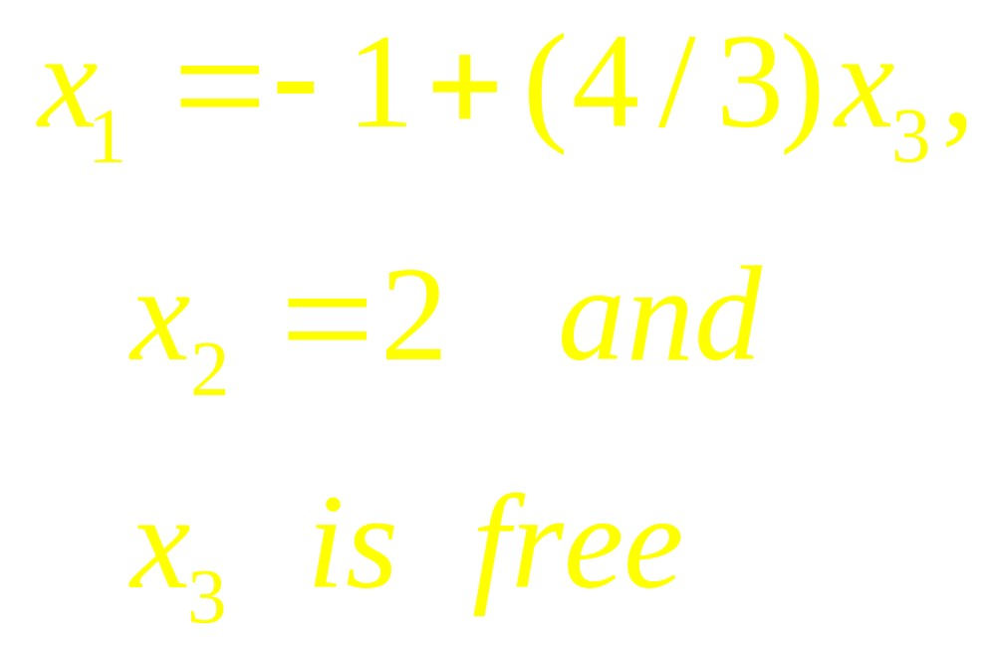
Solution

Slide 19
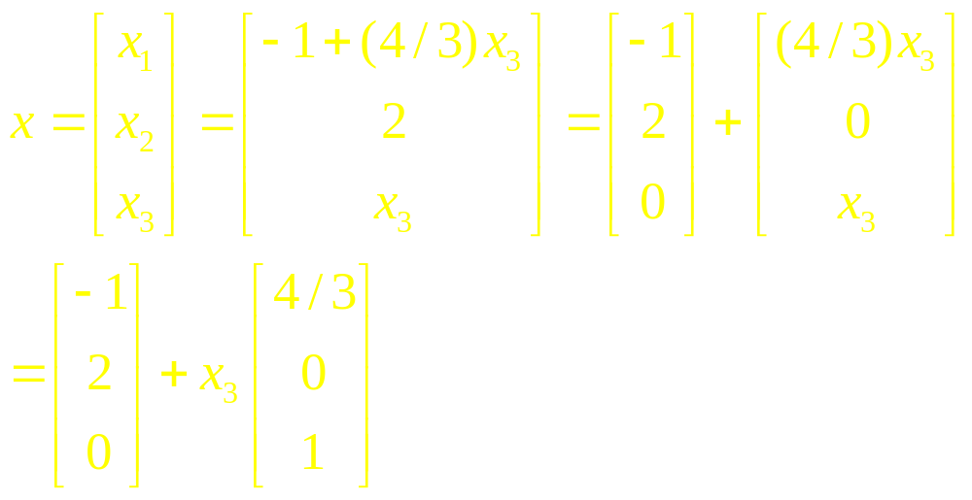
Solution

Slide 20
Parametric Form
The equation x = p + x₃v, or, writing t as a general parameter,
x = p + tv (t in R)
describes the solution set of Ax = b in parametric vector form.

Slide 21
Theorem

Slide 22
Writing a Solution Set
(of a Consistent System)
in a Parametric Form

Slide 23
Examples

Slide 24
Linear Algebra
Lecture 7

